Slide 1
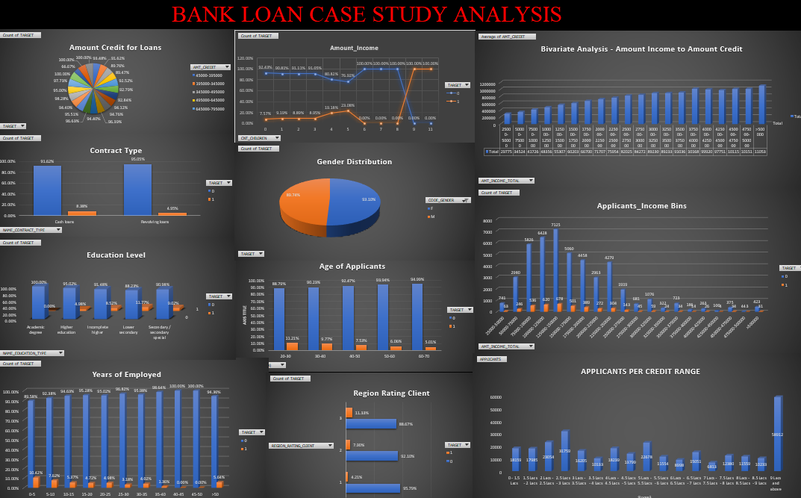
Bank Loan Case Study
By :- Mr. Raj Rathod

Slide 2
Business Overview
The primary objective of this project is to discern patterns indicative of customers encountering challenges in paying their installments.
This insight will inform strategic decisions, including loan denial, adjustment of loan amounts, or offering loans at higher interest rates to high-risk applicants.
The company seeks to unravel the critical factors contributing to loan default to enhance decision-making regarding loan approvals.
Employing Exploratory Data Analysis (EDA) to comprehend how customer characteristics and loan features influence default likelihood.
EDA aims to enhance our understanding of the relationship between customer attributes and loan characteristics, ultimately aiding in risk assessment.

Slide 3
Project Description
1. Description:
- I am a data analyst at a finance company specializing in lending to urban customers.
- Challenge: Some customers with insufficient credit history default on loans.
- Task: Use Exploratory Data Analysis (EDA) to analyze data patterns and prevent capable applicants from being rejected.
2. Risks Faced:
- Rejection of capable applicants leads to lost business.
- Approval of incapable applicants results in financial losses.
3. Dataset Overview:
- Contains loan application information.
- Scenarios:- Customers with payment difficulties: Late payment of more than X days on first Y installments.- Other cases: Payments made on time.
4. Possible Outcomes of Loan Application:
- Approved: Loan application accepted.
- Cancelled: Customer cancels application during approval process.
- Refused: Loan application rejected by the company.
- Unused Offer: Loan approved but not utilized by the customer.

Slide 4
Project Introduction
Illustrates practical implementation of Exploratory Data Analysis (EDA) in a real-world business setting which is a Bank in My Case.
Application of EDA techniques acquired during the module.
Development of a fundamental understanding of risk analytics in banking and financial services.
Demonstrates leveraging data to mitigate risks associated with consumer lending.
Highlights challenges in loan granting at banks.
Shows how data and risk analytics can minimize lending risks.
Utilizes data relationships and visualizations to identify potential loan defaulters.

Slide 5


Tech-Stack Used
Microsoft Excel 2021
Microsoft PowerPoint
Microsoft Excel 2021: Utilized for data cleaning, outlier detection, and conducting univariate and bivariate analysis using pivot tables and charts.
Microsoft PowerPoint: Employed for presentation purposes, summarizing key findings and insights derived from the bank loan case study analysis project.

Slide 6
Approach
This case study involves two extensive datasets: the ‘application_data’ and the ‘previous_application’.
These datasets contained numerous unnecessary columns and blank entries, which were deemed irrelevant for risk assessments, prompting an initial cleaning process.
To assess this vast amount of data effectively, the first step involved cleaning the datasets, identifying and removing outliers.
Subsequently, univariate and bivariate analysis was conducted using pivot tables and charts to delve deeper into the data and derive meaningful insights.

Slide 7
Data Landscape
application_data.csv: Contains comprehensive information about the client at the time of application, focusing on their payment difficulties.
previous_application.csv: Provides insights into the client's prior loan data, including approval, cancellation, refusal, or unused offers.
columns_description.csv: Serves as a data dictionary, detailing the meaning of variables present in the datasets.

Slide 8
A. To Identify Missing Data & Deal with it Appropriately
Initially, I utilized the COUNTA function to determine the total number of rows in each column/variable. Then, I calculated the percentage of null values in each column using the formula: (Total rows count for each column / Total rows count) * 100.
Subsequently, columns with a null value percentage exceeding 30% were eliminated, while those with less than 30% underwent distribution statistics analysis, including mean and mode, to address missing values.
I retained only pertinent variables to extract meaningful insights and standardized the time units by converting days to years, dividing by 365.
Furthermore, outliers were identified utilizing the interquartile range method, focusing on relevant variables.

Slide 9
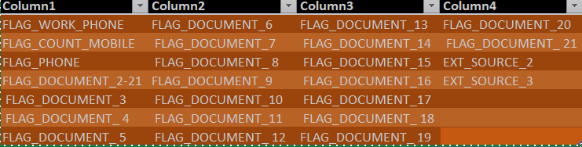
DATA CLEANING - COLUMNS REMOVED
FLAG_WORK_PHONE FLAG_COUNT_MOBILE FLAG_PHONE FLAG_DOCUMENT_2-21 FLAG_DOCUMENT_3 FLAG_DOCUMENT_ 4 FLAG_DOCUMENT_ 5 FLAG_DOCUMENT_6 FLAG_DOCUMENT_7 FLAG_DOCUMENT_ 8 FLAG_DOCUMENT_9 FLAG_DOCUMENT_10 FLAG_DOCUMENT_11 FLAG_DOCUMENT_ 12 FLAG_DOCUMENT_13 FLAG_DOCUMENT_14 FLAG_DOCUMENT_15 FLAG_DOCUMENT_16 FLAG_DOCUMENT_17 FLAG_DOCUMENT_ 18 FLAG_DOCUMENT_ 19 FLAG_DOCUMENT_20 FLAG_DOCUMENT_ 21 EXT_SOURCE_2 EXT_SOURCE_3

Slide 10
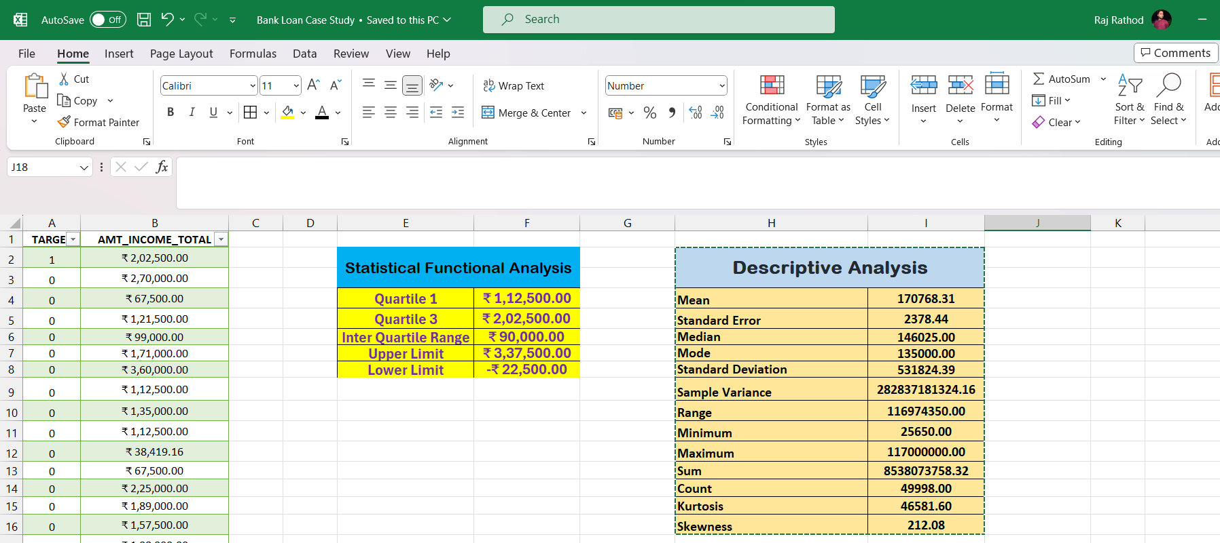
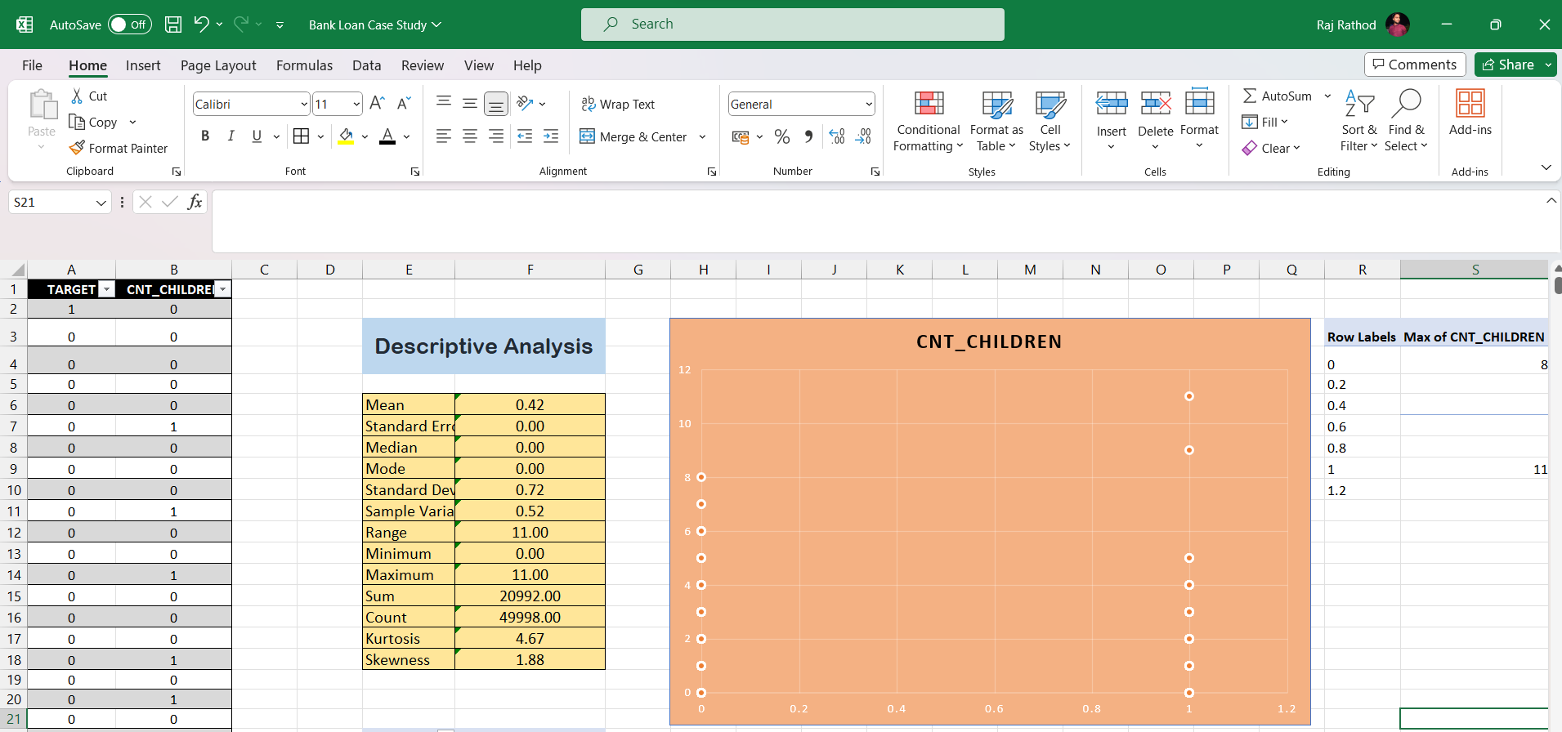
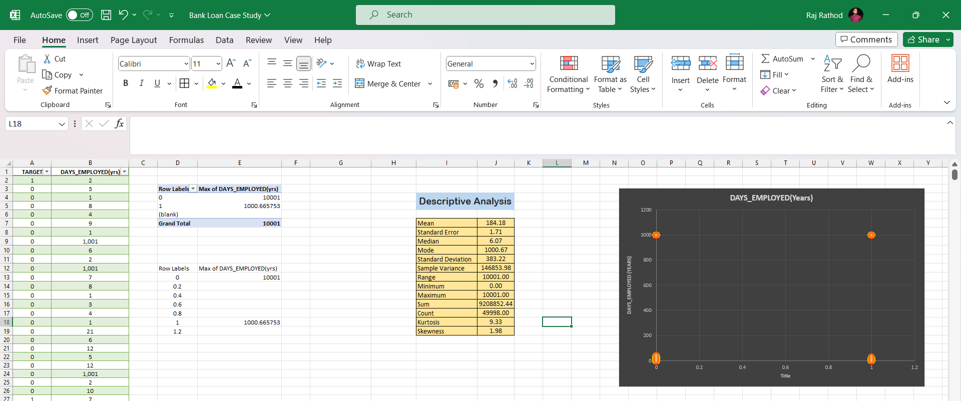
B. Identify Outliers in the Dataset:

Slide 11
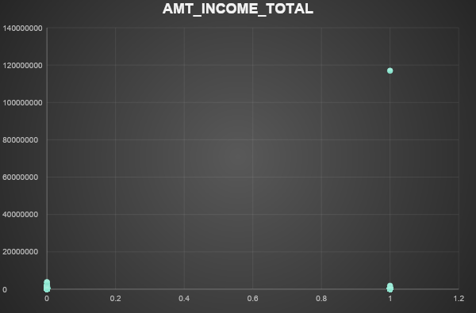
1. Outliers for AMT_INCOME_TOTAL -
Descriptive Analysis
Mean | 170768.31
Standard Error | 2378.44
Median | 146025.00
Mode | 135000.00
Standard Deviation | 531824.39
Sample Variance | 282837181324.16
Range | 116974350.00
Minimum | 25650.00
Maximum | 117000000.00
Sum | 8538073758.32
Count | 49998.00
Kurtosis | 46581.60
Skewness | 212.08
Row Labels | AMT_INCOME_TOTAL
0 | 3825000
0.2
0.4
0.6
0.8
1 | 117000000
1.2
Statistical Functional Analysis
Quartile 1 | ₹ 1,12,500.00
Quartile 3 | ₹ 2,02,500.00
Inter Quartile Range | ₹ 90,000.00
Upper Limit | ₹ 3,37,500.00
Lower Limit | -₹ 22,500.00
In this XY plotter, it's evident that for the target variable 1, there's a small number of applicants with an income of 11 crores, while the majority have incomes in the lakhs range.

Slide 12
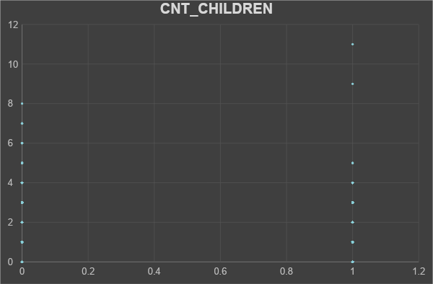
2. Outliers for CNT_CHILDREN
Descriptive Analysis
Mean | 0.42
Standard Error | 0.00
Median | 0.00
Mode | 0.00
Standard Deviation | 0.72
Sample Variance | 0.52
Range | 11.00
Minimum | 0.00
Maximum | 11.00
Sum | 20992.00
Count | 49998.00
Kurtosis | 4.67
Skewness | 1.88
Row Labels | Max of CNT_CHILDREN
0 | 8
0.2
0.4
0.6
0.8
1 | 11
1.2
In this XY plotter, it's evident that among the target variable O applicants, the maximum number of children observed is 8, a rarity in contemporary contexts. Conversely, for target 1 applicants, the maximum number of children observed is 11.

Slide 13
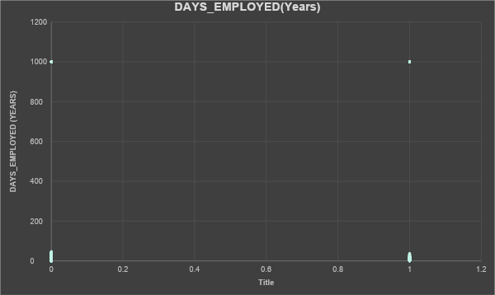
3. Outliers for DAYS_EMPLOYED(Years)
Descriptive Analysis
Mean | 184.18
Standard Error | 1.71
Median | 6.07
Mode | 1000.67
Standard Deviation | 383.22
Sample Variance | 146853.98
Range | 10001.00
Minimum | 0.00
Maximum | 10001.00
Sum | 9208852.44
Count | 49998.00
Kurtosis | 9.33
Skewness | 1.98
Row Labels | Max of DAYS_EMPLOYED(yrs)
0 | 10001
0.2
0.4
0.6
0.8
1 | 1000.665753
1.2
In this XY plotter, it's evident that a small number of applicants in both target groups 0 and 1 are shown as being employed for 1000 years, which is clearly impossible. Conversely, the majority of applicants appear to have employment durations ranging from around 80 to 90 years.

Slide 14
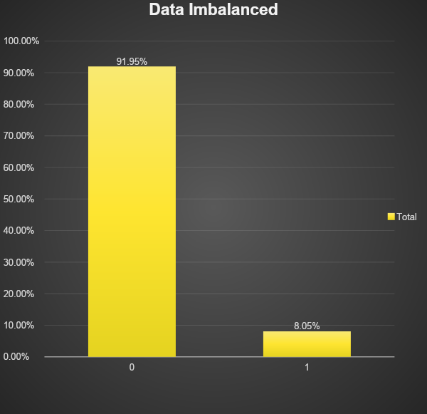
C. Analyse Data Imbalanced
In the Excel file provided, the "Data Imbalanced" sheet illustrates the ratio between two categories: applicants facing payment difficulties (Target 1) and those making payments on time (Target 0), with a ratio of 11:41.
Out of the total applicant pool of 49999, 91.95% successfully make payments on time, constituting the majority class. Conversely, the remaining 8.05% experience payment difficulties, forming the minority class.

Slide 15
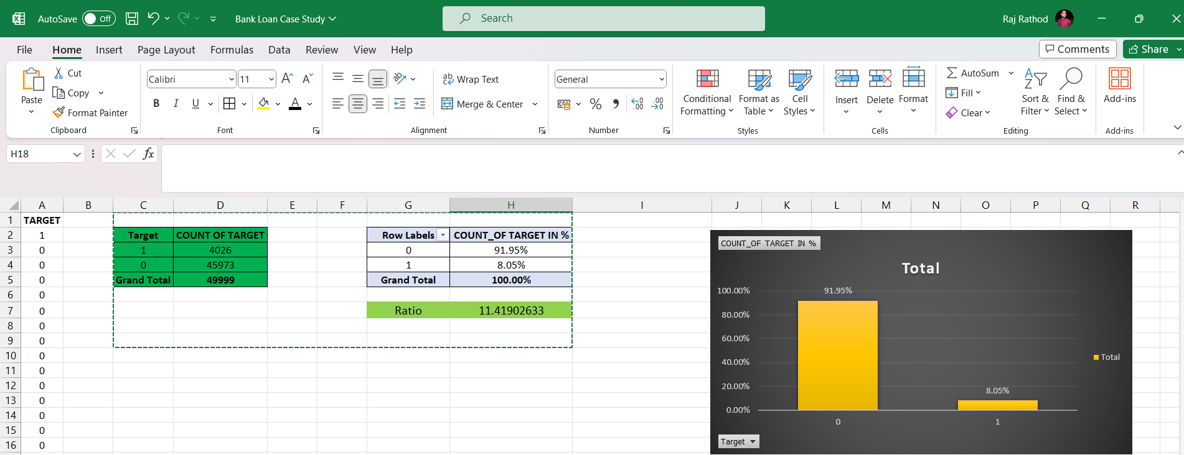
Data Imbalanced
Target | COUNT OF TARGET |  |  | Row Labels | COUNT_OF TARGET IN %
1 | 4026 |  |  | 0 | 91.95%
0 | 45973 |  |  | 1 | 8.05%
Grand Total | 49999 |  |  | Grand Total | 100.00%
 |  |  |  | Ratio | 11.41902633

Slide 16
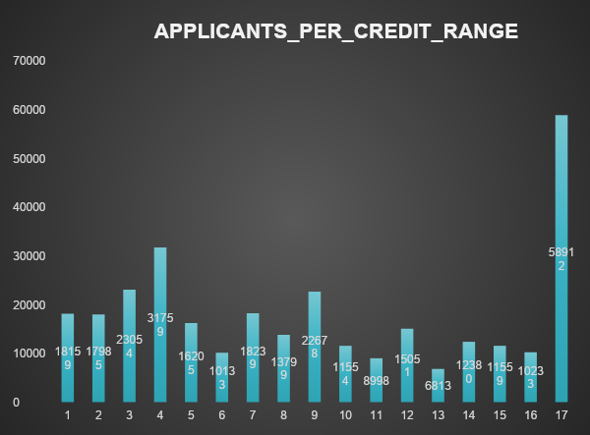
D. To Perform: Univariate, Segmented Univariate and Bivariate Analysis:
Univariate Analysis involves examining data that consists of a single variable. It focuses on describing the data and identifying existing patterns, rather than exploring causes or relationships.
The graph presented here illustrates univariate analysis by displaying the count of loan applicants (0 & 1) for various income brackets within the "AMT_CREDIT" column. The majority of applicants received loan approvals within the credit range of 9 lakhs and above.

Slide 17
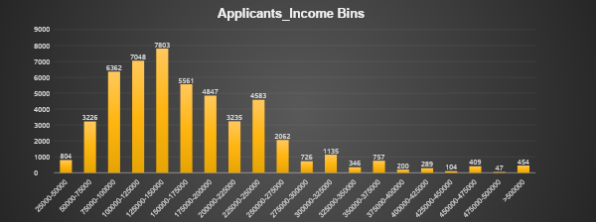
2.Segmented Variate Analysis
Segmented Univariate analysis involves examining data containing only one variable. In this context, segmented analysis refers to dissecting a variable into subsets for analysis.
The graph above illustrates segmented analysis, revealing that the majority of applicants (0 & 1) earn between 1 lakh and 2.25 lakhs. Notably, very few target 1 applicants earn 5 lakhs or more, which could contribute to payment difficulties.

Slide 18
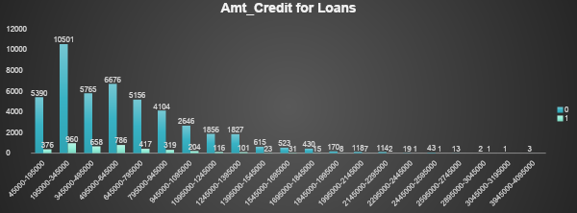
3.Bivariate Analysis
Bivariate analysis involves examining data that includes two distinct variables. It explores the connections and causations between these variables, aiming to uncover their relationship.
The graph above illustrates the correlation between applicants and various income brackets, demonstrating a direct proportionality between the two.
Consequently, as income rises, the amount of credit also increases.

Slide 19
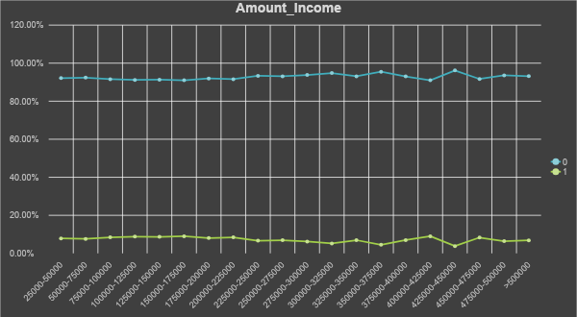
3.Bivariate Analysis
The line above illustrates the correlation between applicants and various income brackets, demonstrating a direct proportionality between the two.
Consequently, as income rises, the amount of credit also increases.

Slide 20
E .To Identify Top Correlations for Different Scenarios:
- Understanding correlations between variables and the target variable can unveil significant indicators of loan default.
- Task: Utilize Excel functions to segment the dataset based on various scenarios, such as clients experiencing payment difficulties and all other cases.
- Identify the top correlations within each segmented dataset to discern key relationships contributing to loan default.

Slide 21
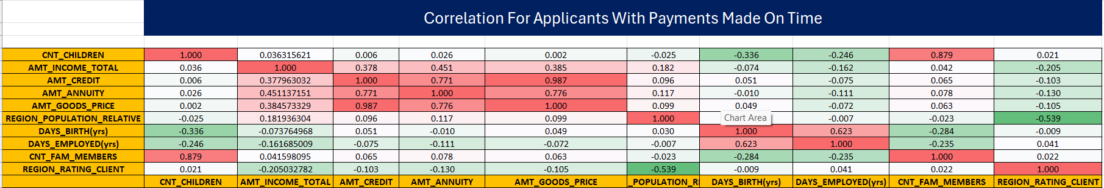
Correlation for Applicants with Payment Made On Time
The heatmap above illustrates the correlation among various variables for target 0, representing applicants who made payments on time.
In the heatmap, red indicates the strongest correlation, while green indicates the weakest correlation between variables.
Key correlations observed include:- AMT_TOTAL_INCOME to AMT_CREDIT- DAYS_BIRTH to DAYS_EMPLOYED- DAYS_EMPLOYED to DAYS_ID_PUBLISH

Slide 22
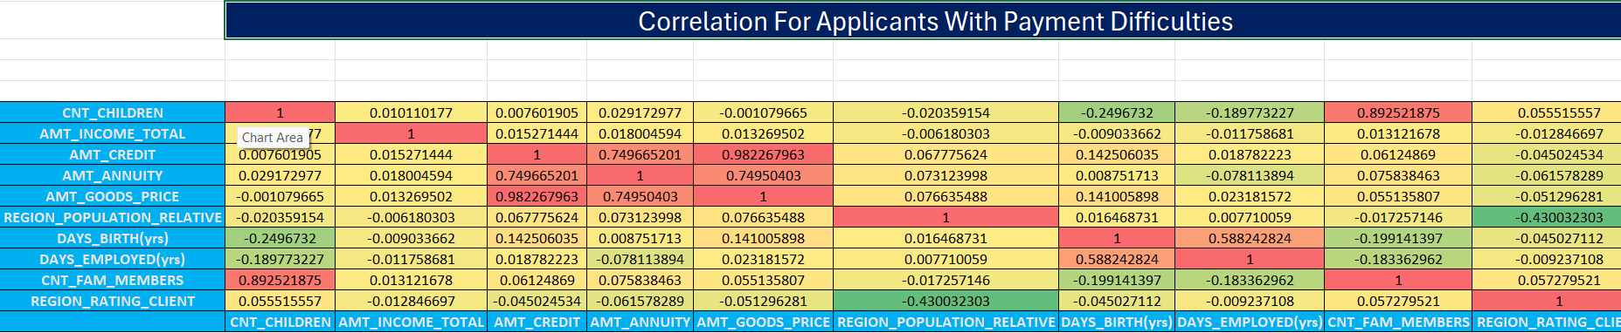
Correlation for Applicants with Payment Difficulties
The heatmap above illustrates the correlation among various variables for target 0, representing applicants facing payment difficulties.
The heatmap colour scheme ranges from red, indicating the strongest correlation, to green, indicating the weakest correlation between variables.
Consequently, the most significant correlations are observed between DAYS_BIRTH and DAYS_EMPLOYED, as well as between DAYS_ID_PUBLISH and DAYS_BIRTH.

Slide 23
Insights
Applicants drawing the higher income were offered the higher credit amount.
Majority of the applicants got loan approval of credit range 9 lacs and above.
Most of the applicants(0&1) drawing an income between 1lacs - 2.25 lacs.
Through our analysis, we addressed several factors influencing the likelihood of client default:
Age and experience correlate inversely with default probability. Priority may be given to older, more experienced clients by the bank.
Educated clients, particularly those with higher levels of education, demonstrate lower default rates compared to those with lower educational attainment.
Male clients exhibit a higher likelihood of default compared to female clients.
Region Rating 3 comprises the highest percentage of defaulters, suggesting the need for stricter loan conditions. Conversely, clients from Region 1 present the lowest default risk.
An observable trend indicates that as clients age, loan amounts tend to increase. Despite this, older clients with higher ages may pose lower default risks and potentially yield higher profitability.
Furthermore, clients with more than two children exhibit higher default frequencies compared to others.

Slide 25
Result
• This case study exemplifies the practical application of Exploratory Data Analysis (EDA) within a real business context, specifically Bank Loan Analysis.
• Through this project, I acquired a fundamental understanding of risk analytics in banking and financial services, grasping how data is instrumental in mitigating lending risks.
• The project presented formidable challenges, particularly in analyzing correlations among variables to derive meaningful insights for clients.
• I gained insights into addressing data imbalances, identifying outliers, and understanding the key drivers within datasets.
• Visualization played a pivotal role in synthesizing complex datasets, facilitating the communication of crucial findings beneficial to the client.

Slide 26
THANK YOU!
Bank Loan Case Study Analysis By EDA Method by Mr. Raj Rathod
LinkedIn – www.linkedin.com/in/rajrathod54321
Excel Sheet Link
Video Presentation Link

